Slide 1
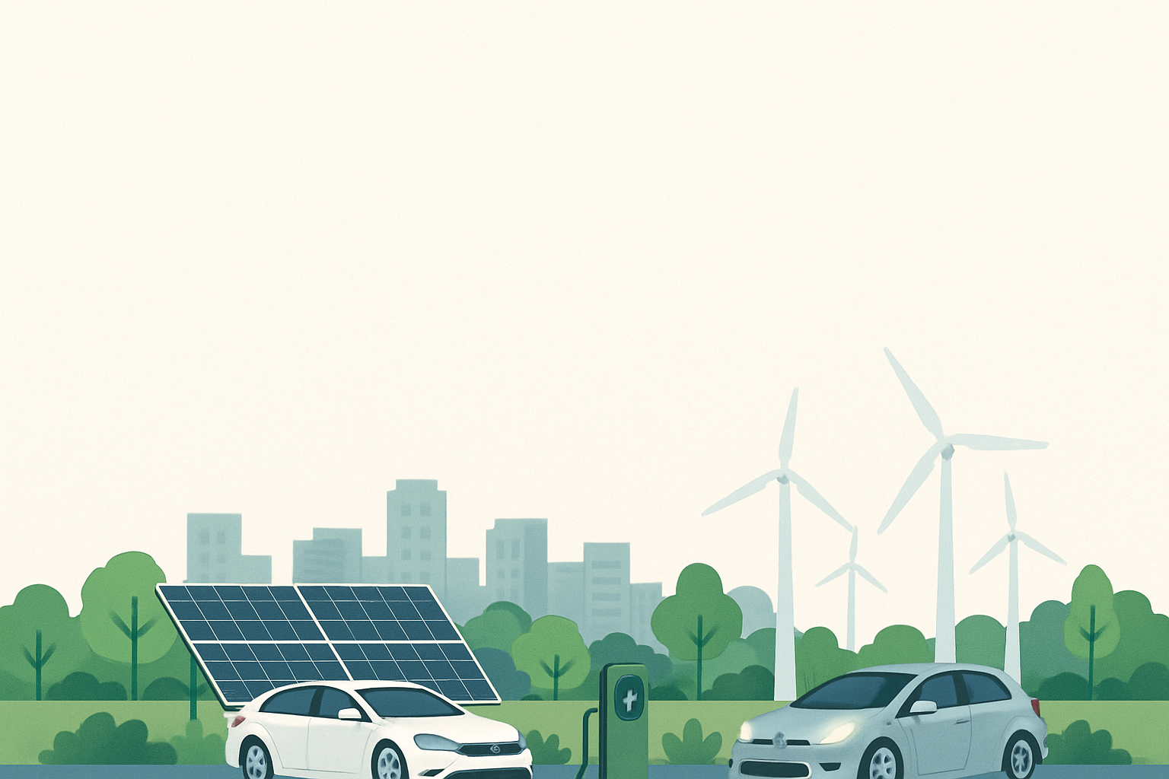







Paper ID:279
GrowSmart: A Dual-Stage Machine Learning and Deep Learning Framework for Urban Agriculture
Patalam Nayeem, Team Members
Presented by
Mr. Nayeem Patalam
B.Tech (Computer Science & Engineering)
Narasaraopeta Engineering College
IEEE International Conference on Smart Power, Energy, Renewables, and Transportation
IEEE-SPERT 2025, SVNIT Surat, Gujarat, India

Slide 2

Motivation
Agriculture faces challenges due to climate change, soil degradation, and disease outbreaks
Farmers rely on experience-based decisions rather than data-driven insights
Separate systems exist for crop prediction and disease detection
Lack of an integrated, intelligent decision-support system

Slide 3
Problem Statement
Incorrect crop selection leads to reduced yield
Late disease detection causes heavy crop loss
Excessive or insufficient fertilizer usage degrades soil
Existing systems lack integration and real-time support
Problem:
Need for a smart, automated, and scalable agricultural decision-support system.

Slide 4
Objectives
Predict the most suitable crop using soil and climate data
Detect plant diseases using leaf images
Recommend appropriate fertilizers based on nutrient deficiency
Integrate ML and DL models into a single web platform
Provide real-time and user-friendly decision support

Slide 5
Proposed Solution (GrowSmart)
Dual-stage AI framework:
Machine Learning for crop recommendation
Deep Learning for disease detection
Fertilizer recommendation based on NPK analysis
Web-based system using Flask
Designed for both urban and rural agriculture

Slide 6
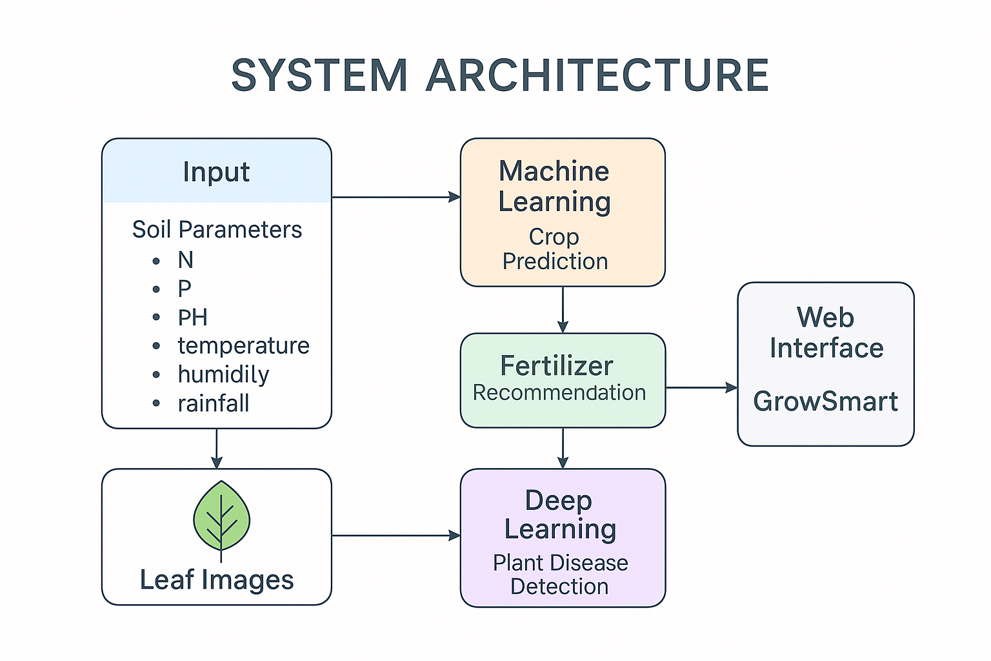
System Architecture
Architecture Highlights:
Input: Soil parameters & leaf images
ML model predicts suitable crop
DL model detects plant disease
Fertilizer logic recommends nutrients
Results displayed via web interface

Slide 7
Dataset & Preprocessing
Crop dataset: N, P, K, pH, temperature, humidity, rainfall
Disease data set : Leaf image of multiple crop diseases
Missing values handled
Feature normalization using StandardScaler
Image Preprocessing :
- Resize to 224×224
- Data augmentation (rotation, flip, zoom)

Slide 8
Machine Learning Model (Crop Recommendation)
Algorithms tested:
1.Random Forest
2.Decision Tree
3.SVM
4.Naive Bayes
Random Forest selected
- Highest accuracy
- Robust to non-linear data
Model saved using Joblib
Integrated into Flask backend

Slide 9
Deep Learning Model (Disease Detection)
Custom ResNet-9 architecture
Implemented using PyTorch
Residual connections reduce vanishing gradient problem
Data augmentation reduces overfitting
Output:
- Disease class
- Confidence score

Slide 10
Fertilizer Recommendation Module
Compares actual NPK values with optimal crop requirements
Identifies nutrient deficiency
Suggests:
- Nitrogen-rich fertilizer
- Phosphorus-rich fertilizer
- Potassium-rich fertilizer
- Balanced fertilizer
Fully automated Python logic

Slide 11
Web Application Implementation
Backend:
- Flask framework
- ML + DL model integration
API Routes:
- /crop-recommend
- /fertilizer
- /disease-predict
Frontend:
- HTML, CSS, Bootstrap, JavaScript
Dynamic State – City dropdown using cities.js

Slide 12
Results & Evaluation
High accuracy achieved for crop recommendation
ResNet-9 showed strong disease classification performance
Confusion matrices validate model reliability
System responds in real time
Suitable for deployment in practical farming environments

Slide 13
Advantages of GrowSmart
Integrated crop, fertilizer, and disease prediction
Data-driven decision making
Lightweight deep learning model
User-friendly web interface
Scalable and adaptable across regions

Slide 14
Conclusion
GrowSmart provides an end-to-end AI-based agricultural solution
Combines ML and DL effectively
Enhances productivity and reduces manual dependency
Supports sustainable and precision agriculture

Slide 15
Future Scope
Integration with IoT sensors
Mobile application deployment
Multilingual farmer support
Cloud-based large-scale deployment
Inclusion of yield prediction and irrigation planning

Slide 16
Thank you

